Slide 1
Psychedelic Compounds DOI and 5-MeO-DMT Enhance Neurotrophic Signaling and Neurogenesis
Ben Onserio
Serotonergic Psychedelics
February 28, 2020

Slide 2


Neurodegenerative diseases
Neuron Loss

Slide 3
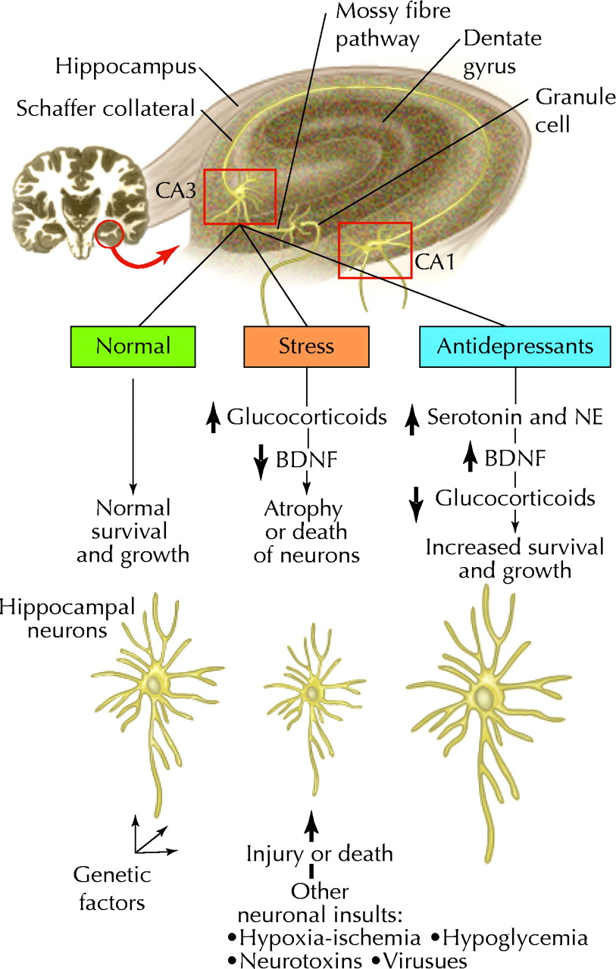
Depression
Neuron Loss
Ronald A. Remick CMAJ 2002;167:1253-1260

Slide 4
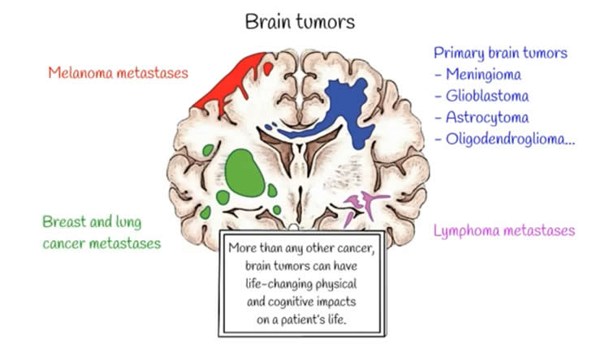
Brain Tumors
Neuron Loss
https://neurosciencenews.com/brain-tumor-apoptosis-10451/

Slide 5
Psilocybin (PSOP)
Psychedelics and Neurogenesis
- Its chronic administration increases new neurons in the hippocampal DG
Neuropathology of Drug Addictions and Substance Misuse, Volume 2. http://dx.doi.org/10.1016/B978-0-12-800212-4.00077-7

Slide 6
Psilocybin (PSOP)
Psychedelics and Neurogenesis
- Its chronic administration increases new neurons in the hippocampal DG
Neuropathology of Drug Addictions and Substance Misuse, Volume 2. http://dx.doi.org/10.1016/B978-0-12-800212-4.00077-7

Slide 7
MDMA
Psychedelics and Neurogenesis
- Utero MDMA exposure increases proliferation and neurogenesis in the DG
Canales, et.al (2014). Dev Neurosci 2014;36:10–17

Slide 8
Hypothesis: DOI and 5-MeO-DMT will augment the expression of neurotrophic factors that promote neurogenesis

Slide 9
DOI (2,5-dimethoxy-4-iodoamphetamine)
It is an agonist for 5-HT2 receptor subtypes
Potency rank: 5-HT2_{A}> 5-HT2_{B}> 5-HT2_{C}
It also activates Trk receptor subtypes
It increases neurotrophic factors expression

Slide 10
Materials and Methods
Cell cultures
- SK-N-SH neuroblastoma cells
- Human neural progenitor cells
- Human cerebral organoids
Western blot and immunoprecipitation
Enzyme-linked-immunosorbent assay (ELISA)
Polymerase chain reaction (PCR)
Immunocytochemistry
In-silico analysis

Slide 11
Timeline of the experimental procedures performed in SK-N-SH cells
Marinova, Z. et al. (2017). J.Neural Transm 124: 749-759.

Slide 12
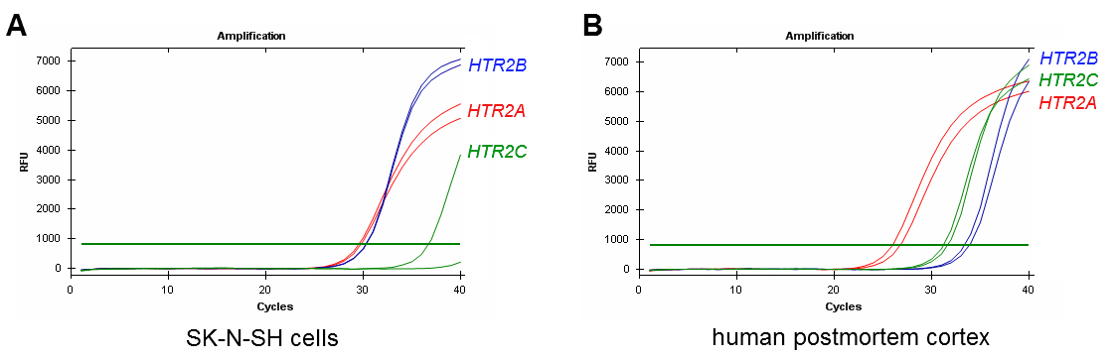
5-HT₂ receptor subtypes are expressed in SK-N-SH Cells
Marinova, Z. et al. (2017). J.Neural Transm 124: 749-759.
Notes:
Figure 6

Slide 13
DOI increases TrkA tyrosine phosphorylation in SK-N-SH cells
Data analyzed by one-way ANOVA with LSD post hoc test
Marinova, Z. et al. (2017). J.Neural Transm 124: 749-759.
Notes:
Figure 4A

Slide 14
DOI increases TrkA tyrosine phosphorylation in SK-N-SH cells
Data analyzed by one-way ANOVA with LSD post hoc test
Marinova, Z. et al. (2017). J.Neural Transm 124: 749-759.

Slide 15
5-HT_{2A} receptor antagonist MDL 11,939 decrease pTyr-TrkA induction
Marinova, Z. et al. (2017). J.Neural Transm 124: 749-759.

Slide 16
DOI augments neurites extension in SK-N-SH cells
Marinova, Z. et al. (2017). J.Neural Transm 124: 749-759.

Slide 17
Take-home message
Hallucinogen DOI activates TrkA receptor through TrKA Tyr490 phosphorylation in SK-N-SH cells
TrkA-dependent increase in neurites extension after DOI treatment

Slide 18
5-MeO-DMT has anti-inflammatory actions and modulates the formation of dendritic spines

Slide 19
5-MeO-DMT ( 5-methoxy-N,N-dimethyltryptamine)
Regulates inflammation and immune homeostasis through 5-HTRs and σ-1 Rs

Slide 20
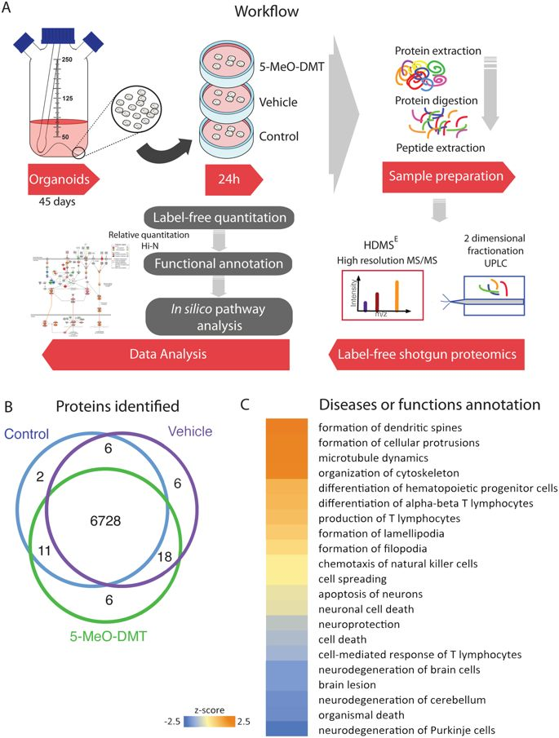
Dakic, V. et al. (2017). Scientific Reports 7: 12863.

Slide 21
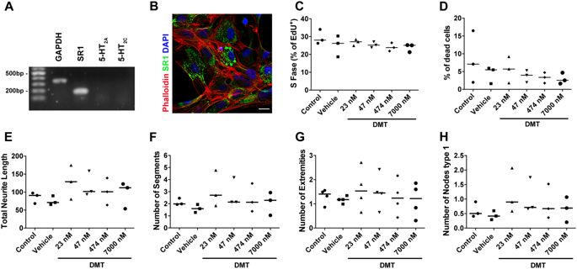
5-HT_{2A} and 5-HT_{2C} receptors are expressed in human neural progenitor cells (hNPC)
Dakic, V. et al. (2017). Scientific Reports 7: 12863.

Slide 22
hNPC are unaffected by 5-MeO-DMT
Data was analyzed by one-way ANOVA with Tukey’s multiple comparison test
Dakic, V. et al. (2017). Scientific Reports 7: 12863.

Slide 23
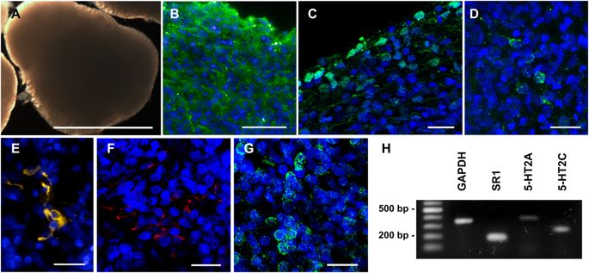
Human cerebral organoids express 5-MeO-DMT receptors
Dakic, V. et al. (2017). Scientific Reports 7: 12863.

Slide 24
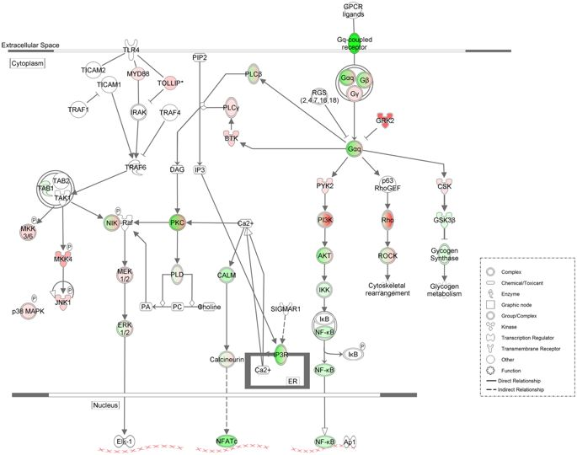
5-MeO-DMT leads to inhibition of NF-_{К}B pathway
Dakic, V. et al. (2017). Scientific Reports 7: 12863.

Slide 25
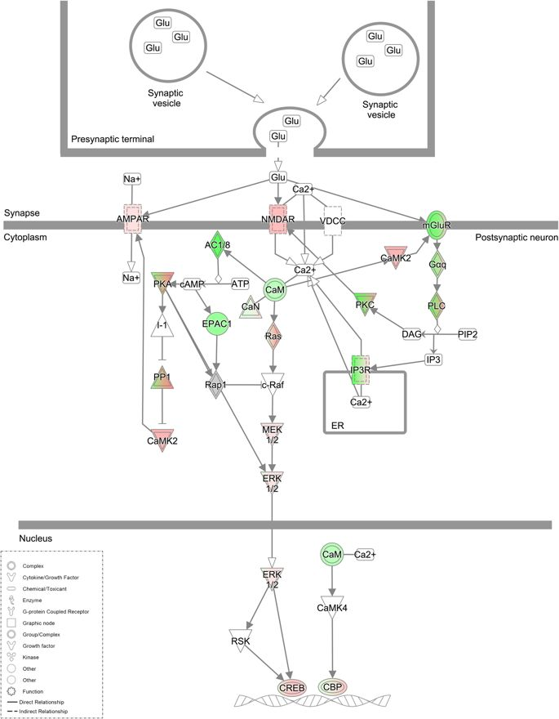
5-MeO-DMT modulates Long-term potentiation (LTP)
Dakic, V. et al. (2017). Scientific Reports 7: 12863.

Slide 26
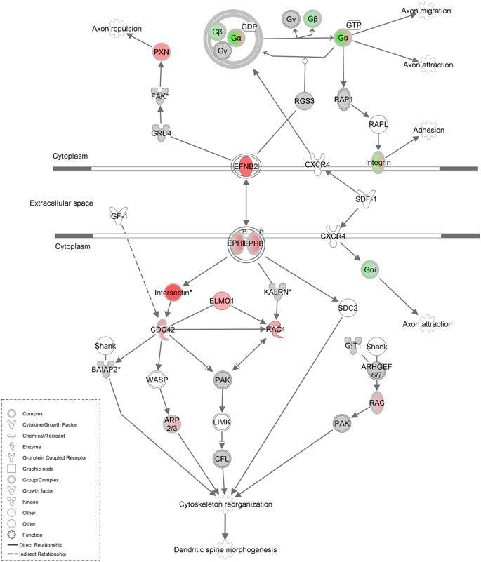
5-MeO-DMT influences cytoskeletal reorganization and dendritic spine morphogenesis
Dakic, V. et al. (2017). Scientific Reports 7: 12863.

Slide 27
Take-home message
5-MeO-DMT modulates proteins involved in long-term potentiation (LTP)
5-MeO-DMT enhances morphogenesis and maturation of dendritic spines
5-MeO-DMT inhibits neurodegeneration and cell death

